Slide 1
Advanced Cryptography （Provable Security） Introduction
Yi LIU

Slide 2
About Me
Yi LIU (刘逸)
Lecturer, College of Cyber Security, Jinan University
Ph.D., The University of Hong Kong
Research Interests: Multi-Party Computation
Email: liuyi@jnu.edu.cn，i@liuyi.pro
Homepage: https://liuyi.pro

Slide 3

Course Information
Time: 14 : 00 – 18 : 00, Friday, Week 2-9
Venue: Room 321
Credit: 2
Course Webpage
https://liuyi.pro/#/teaching/crypto
QQ group: 924950026

Slide 4

Main Textbook
The Joy of Cryptography
by Mike Rosulek
Link: https://joyofcryptography.com

Slide 5
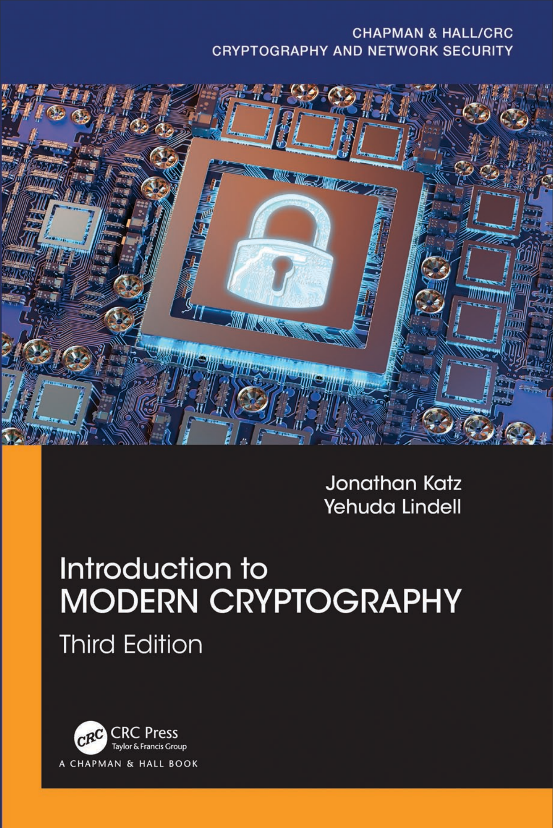
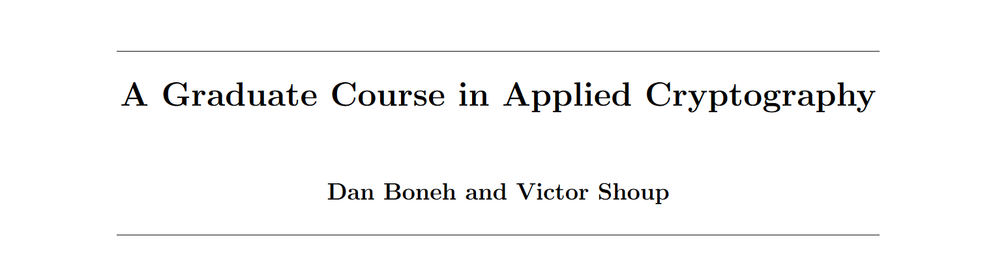

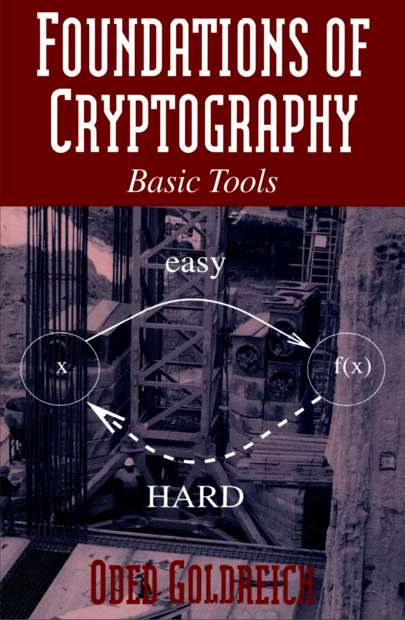
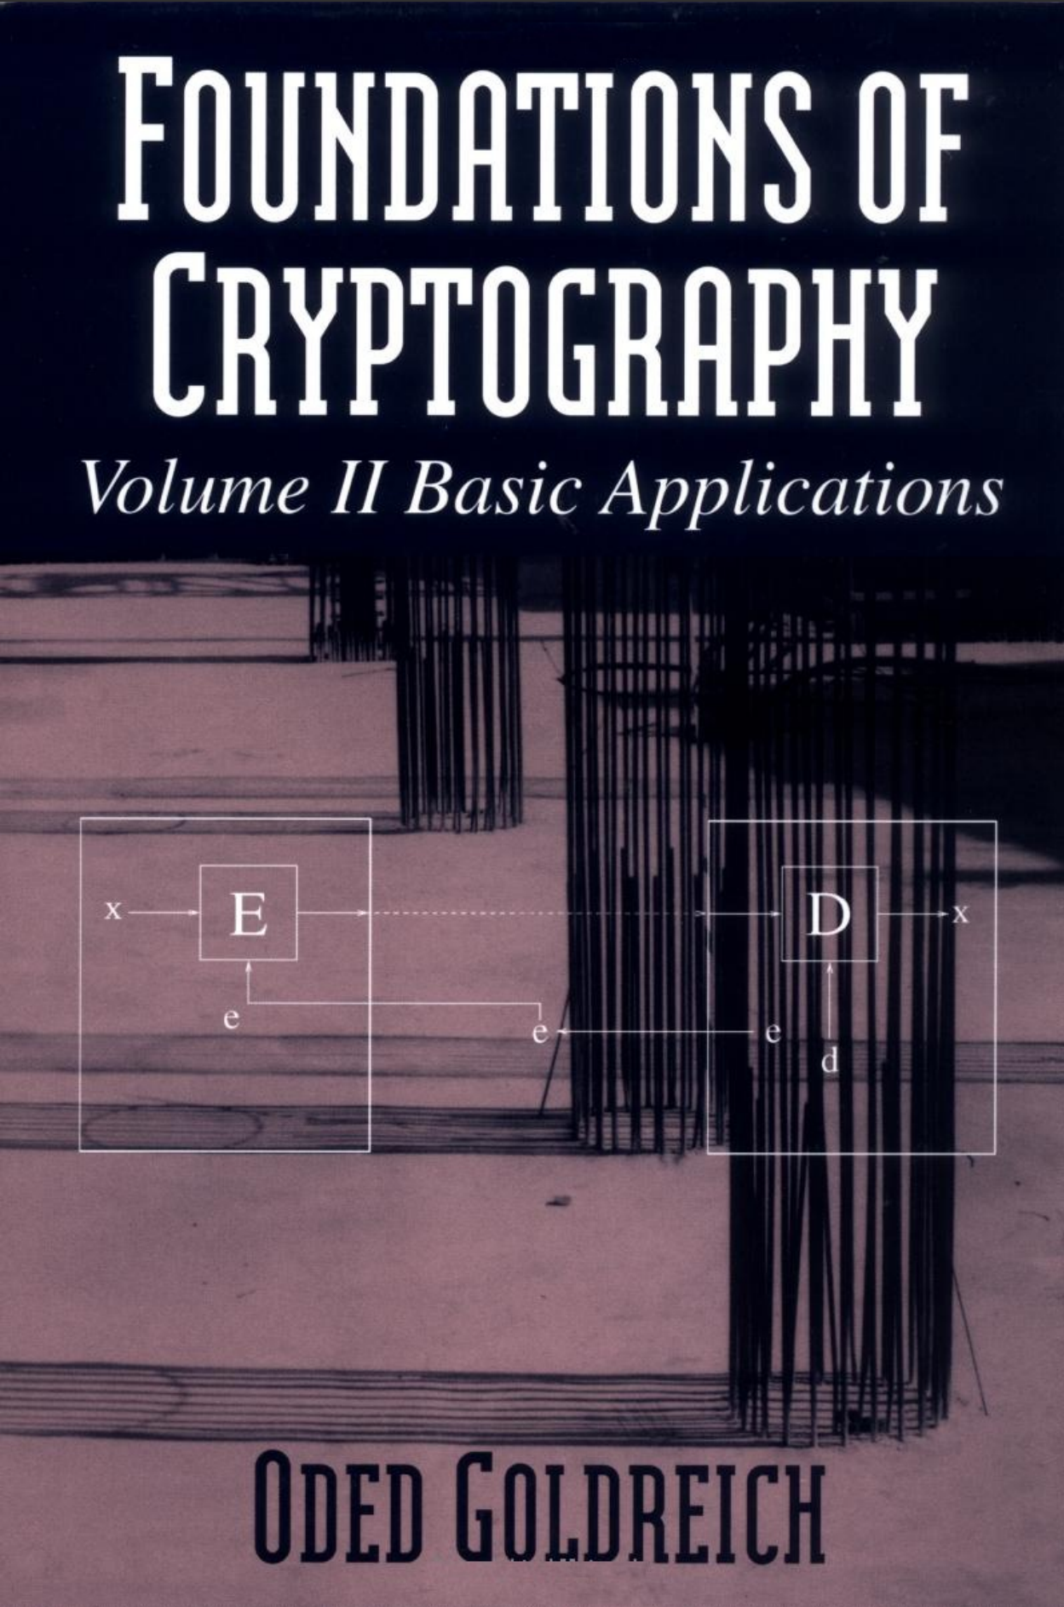
Other Reading Resources

Slide 6
What you will learn
Foundations and principles of the science
Basic primitives and components
Definitions and proofs of security
Will help you understand security proofs in crypto papers

Slide 7
Marking Scheme (Tentative)
Assignment (40%)
MUST be written via LaTeX
Final exam (60%)

Slide 8
Important Messages to Students
Main ideas will be covered in class but some details might be skipped. You are responsible for all materials in the textbook&slides, even if they are not taught in class.
Homework assignments should be worked on and written up individually, though collaboration on homework with other students are encouraged (acknowledge this).
Any unintellectual behavior and cheating on exams, homework assignments will be dealt with severely.

Slide 9
Important Messages to Students
Please ask questions in class
If you’re having trouble understanding something, then at least 50% of the class is also having trouble: they’ll be happy if you ask for more explanation.
If you find mistakes or just think that something’s confusing
Please email me.

Slide 10
Prerequisites of This Course
Required:
Ability to read and write mathematical proofs and definitions.
Familiarity with algorithms – proving correctness and analyzing running time (O notation).
Familiarity with basic probability theory.
Familiarity with discrete mathematics.
Helpful:
Complexity: P, NP, BPP, etc.
Number theory: modular arithmetic, prime numbers, etc.
Probabilistic algorithms: primality testing, etc.

Slide 11
More About This Course
This course is NOT EASY
Emphasis on proofs
Counter-intuitive concepts
Extensive use of quantifiers/probability
Need to acquire “crypto-intuition”

Slide 12
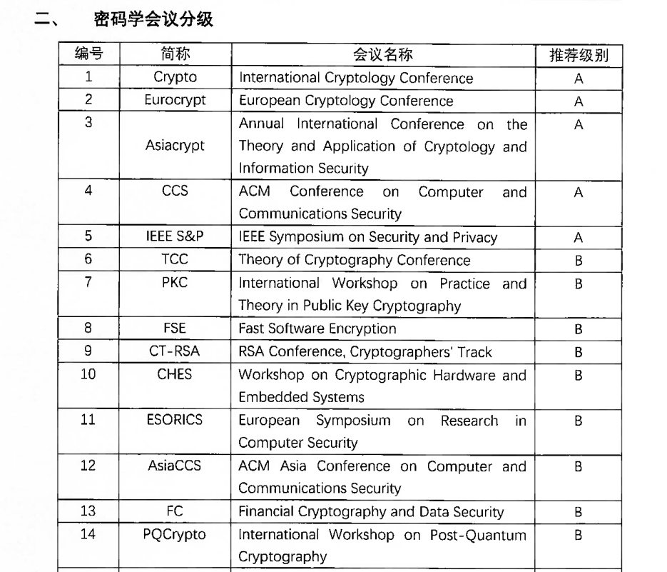
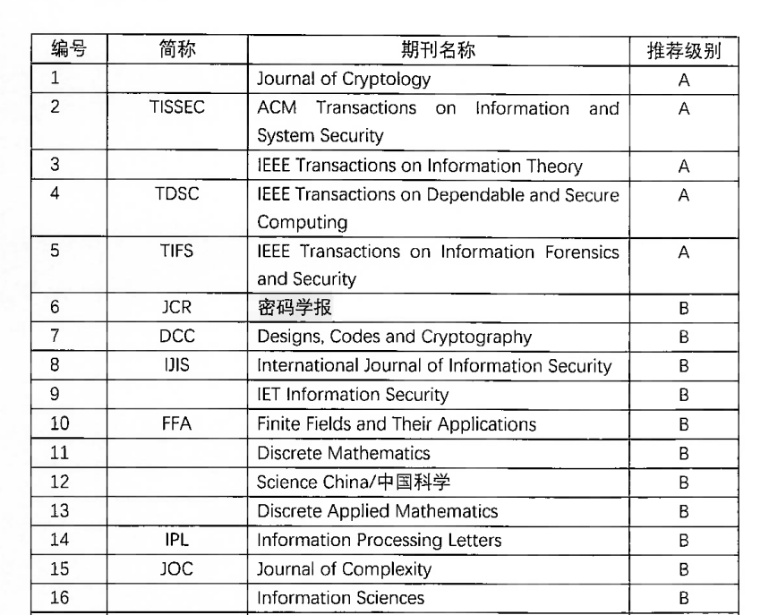
Other Things You Should Know
Where to find paper?
中国密码学会推荐学术刊物和国际会议目录
https://www.cacrnet.org.cn/site/content/1290.html

Slide 13
Other Things You Should Know
Where to find paper?
中国密码学会推荐学术刊物和国际会议目录
https://www.cacrnet.org.cn/site/content/1290.html
Cryptology ePrint Archive
https://eprint.iacr.org/

Slide 14
Review of Concepts & Notation

Slide 15
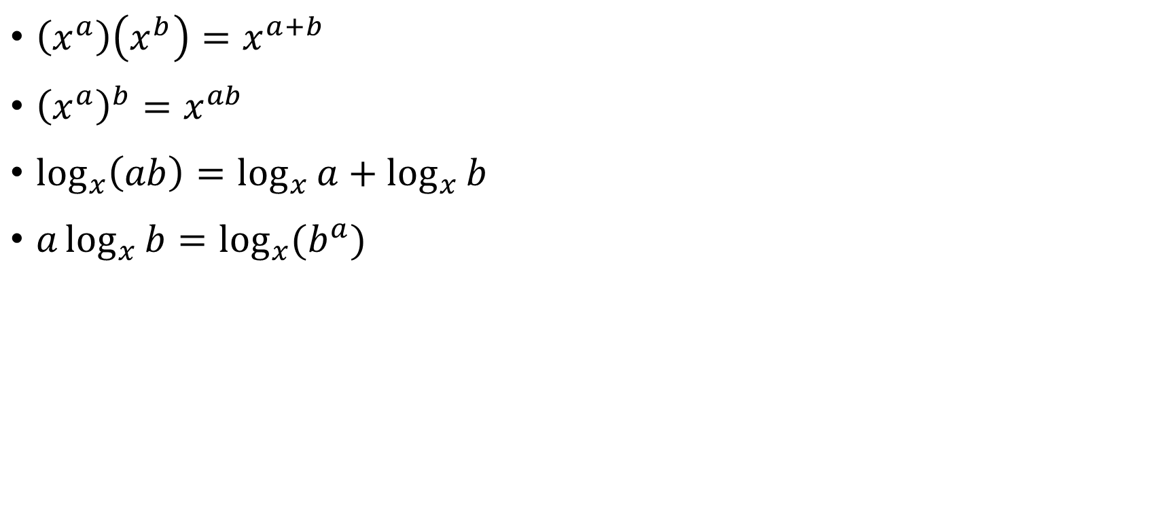
Logs & Exponents
$\left(x^{a}\right)\left(x^{b}\right)=x^{a+b}$
${\left(x^{a}\right)}^{b}=x^{ab}$
$\log_{x}\left(ab\right)=\log_{x}{a}+\log_{x}{b}$
$a\log_{x}{b}=\log_{x}{(b^{a})}$

Slide 16
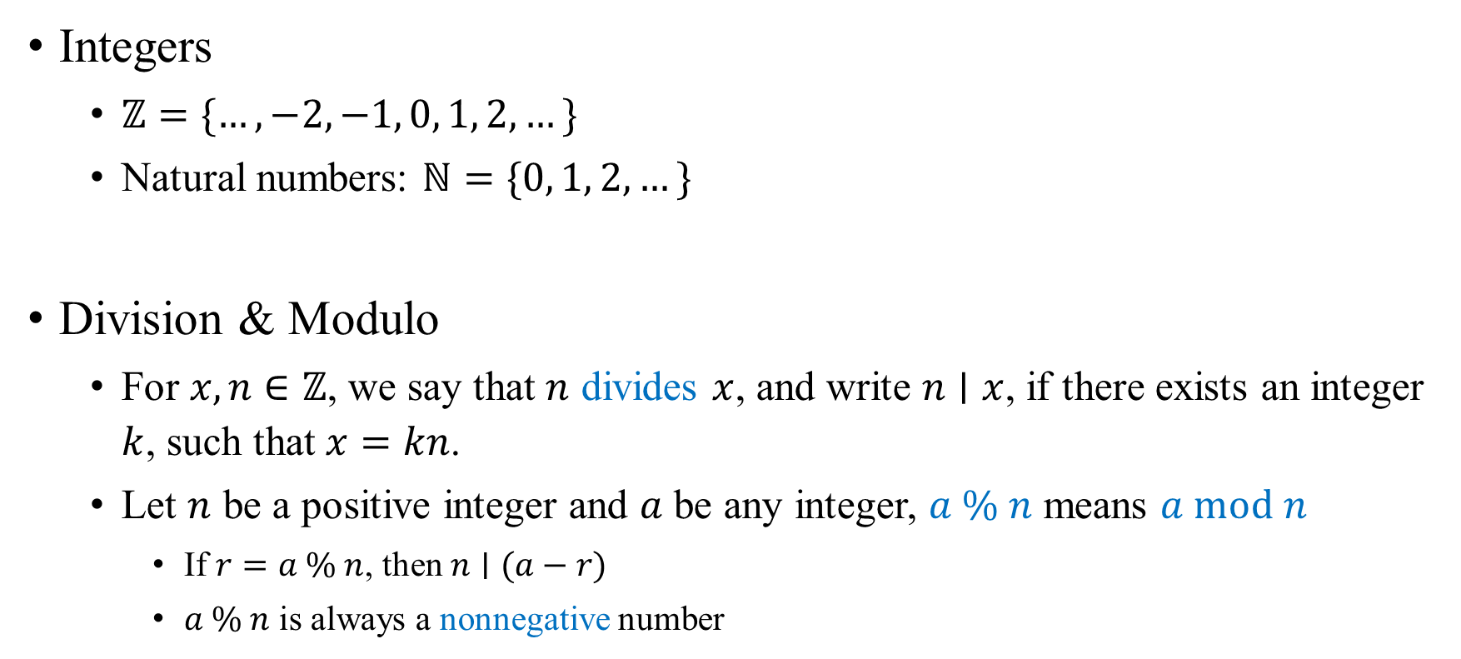
Modular Arithmetic
Integers
$ℤ=\{…, −2, −1, 0, 1, 2, …\}$
Natural numbers: $ℕ=\{0, 1, 2, …\}$
Division & Modulo
For $x, n∈ℤ$, we say that $n$ divides $x$, and write $n∣x$, if there exists an integer $k$, such that $x=kn$.
Let $n$ be a positive integer and $a$ be any integer, $a \% n$ means $a mod n$
If $r=a \% n$, then $n∣(a−r)$
$a \% n$ is always a nonnegative number

Slide 17
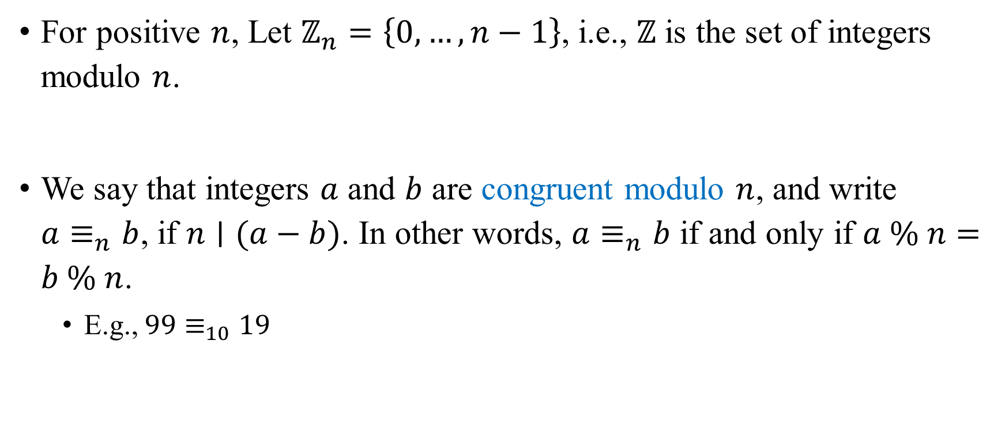
Modular Arithmetic
For positive $n$, Let $ℤ_{n}=\left\{0, …, n−1\right\}$, i.e., $ℤ$ is the set of integers modulo $n$.
We say that integers $a$ and $b$ are congruent modulo $n$, and write $a≡_{n}b$, if $n∣(a−b)$. In other words, $a≡_{n}b$ if and only if $a \% n=b \% n$.
E.g., $99≡_{10}19$

Slide 18
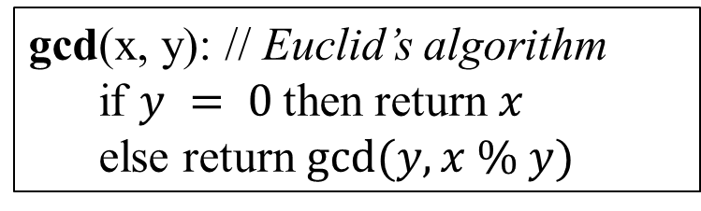
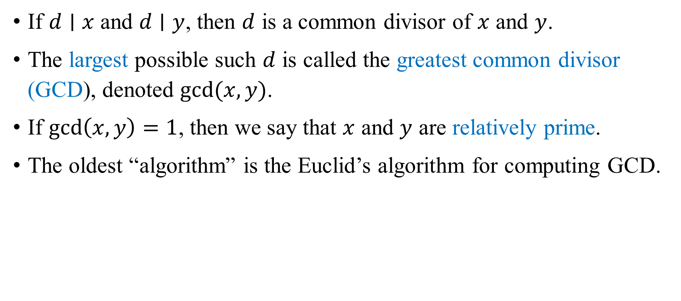
Greatest Common Divisor (GCD)
If $d∣x$ and $d∣y$, then $d$ is a common divisor of $x$ and $y$.
The largest possible such $d$ is called the greatest common divisor (GCD), denoted $gcd⁡(x,y)$.
If $\gcd\left(x,y\right)=1$, then we say that $x$ and $y$ are relatively prime.
The oldest “algorithm” is the Euclid’s algorithm for computing GCD.
gcd(x, y): // Euclid’s algorithm
if $y = 0$then return $x$
else return $gcd⁡(y, x \% y)$

Slide 19
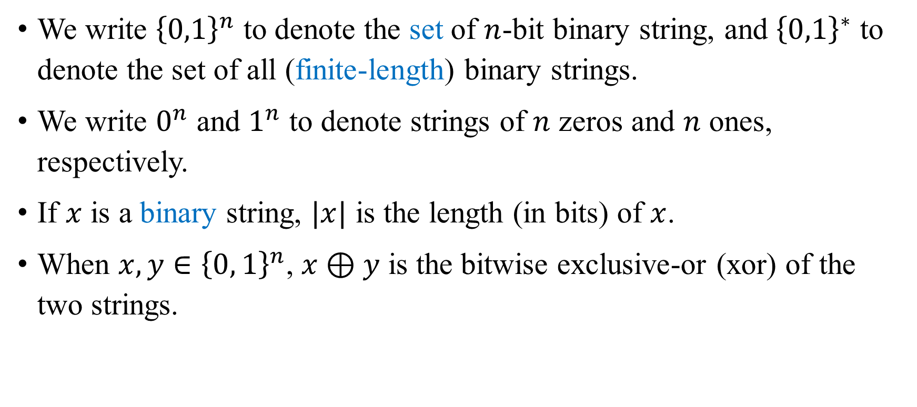
Strings
We write ${\left\{0,1\right\}}^{n}$ to denote the set of $n$-bit binary string, and ${\left\{0,1\right\}}^{∗}$ to denote the set of all (finite-length) binary strings.
We write $0^{n}$ and $1^{n}$ to denote strings of $n$ zeros and $n$ ones, respectively.
If $x$ is a binary string, $|x|$ is the length (in bits) of $x$.
When $x, y∈{\left\{0, 1\right\}}^{n}$, $x⊕y$ is the bitwise exclusive-or (xor) of the two strings.

Slide 20
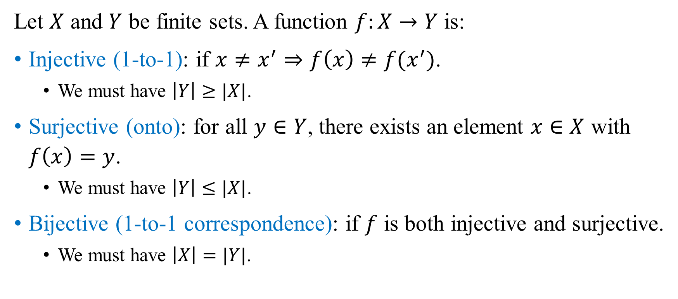
Functions
Let $X$ and $Y$ be finite sets. A function $f:X→Y$ is:
Injective (1-to-1): if $x≠x^{′}⇒f\left(x\right)≠f(x^{′})$.
We must have $\left|Y\right|≥|X|$.
Surjective (onto): for all $y∈Y$, there exists an element $x∈X$ with $f\left(x\right)=y$.
We must have $\left|Y\right|≤|X|$.
Bijective (1-to-1 correspondence): if $f$ is both injective and surjective.
We must have $\left|X\right|=|Y|$.

Slide 21
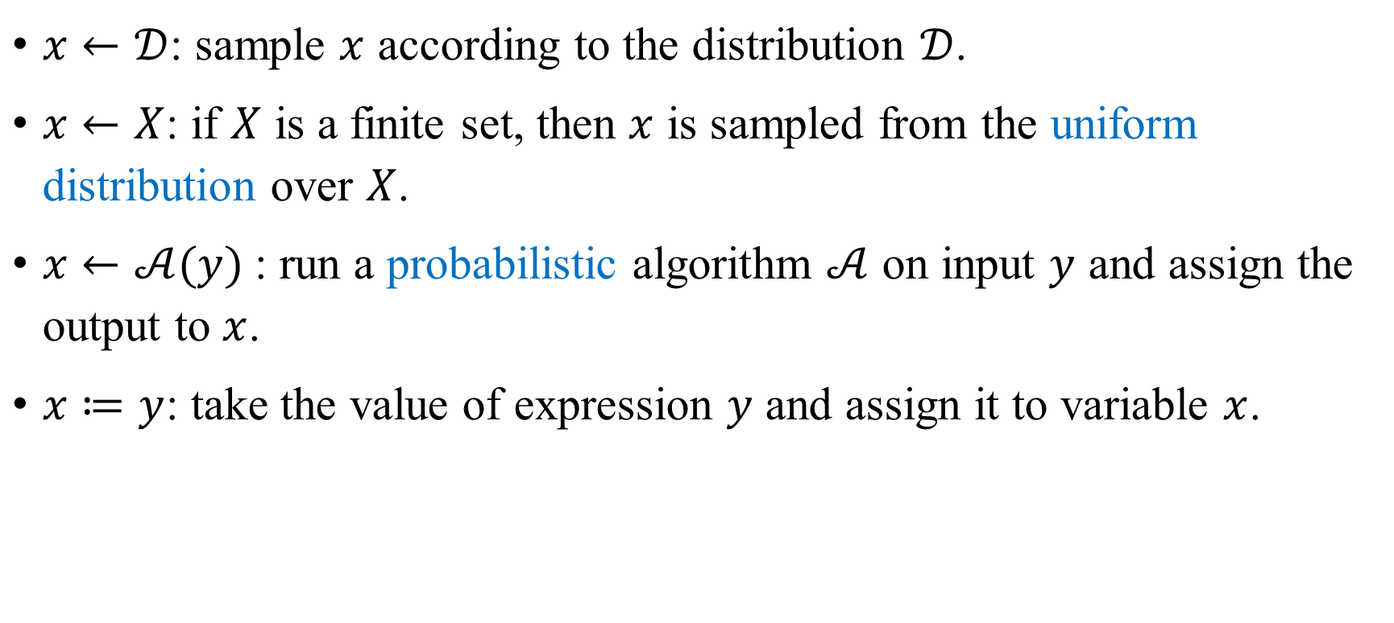
Notation in Pseudocode
$x←𝒟$: sample $x$ according to the distribution $𝒟$.
$x←X$: if $X$ is a finite set, then $x$ is sampled from the uniform distribution over $X$.
$x←𝒜(y)$: run a probabilistic algorithm $𝒜$ on input $y$ and assign the output to $x$.
$x≔y$: take the value of expression $y$ and assign it to variable $x$.

Slide 22
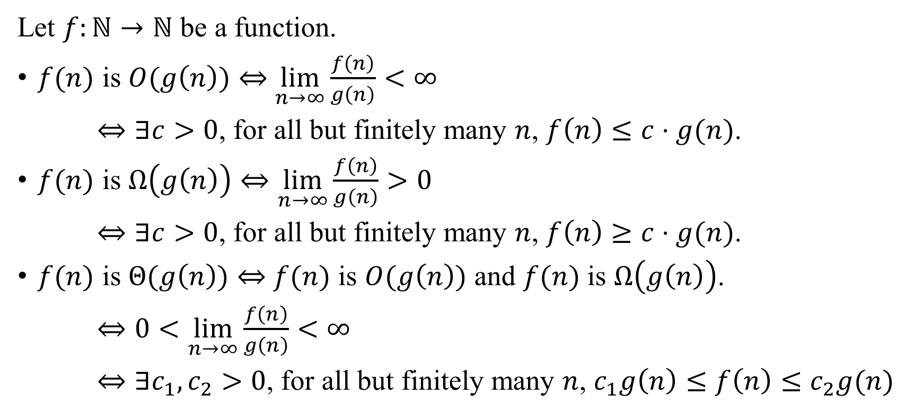
Asymptotics
Let $f:ℕ→ℕ$ be a function.
$f(n)$ is $O(g\left(n\right))$ $⇔$ $\lim_{n→∞}{\frac{f\left(n\right)}{g\left(n\right)}<∞}$
$⇔∃c>0$, for all but finitely many $n$, $f\left(n\right)≤c⋅g(n)$.
$f(n)$ is $Ω\left(g\left(n\right)\right)⇔\lim_{n→∞}{\frac{f\left(n\right)}{g\left(n\right)}>0}$
$⇔∃c>0$, for all but finitely many $n$, $f\left(n\right)≥c⋅g(n)$.
$f(n)$ is $Θ(g\left(n\right))$ $⇔$ $f(n)$ is $O(g\left(n\right))$ and $f(n)$ is $Ω\left(g\left(n\right)\right)$.
$⇔0<\lim_{n→∞}{\frac{f\left(n\right)}{g\left(n\right)}<∞}$
$⇔∃c_{1},c_{2}>0$, for all but finitely many $n$, $c_{1}g\left(n\right)≤f\left(n\right)≤c_{2}g(n)$

Slide 23
Kerckhoffs’ Principle & Perfect Secrecy

Slide 24
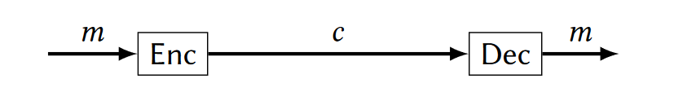


Encryption Scheme
Alice wants to send Bob a secret message.
Algorithms
Key generation (KeyGen)
Encryption (Enc)
Decryption (Dec)

Slide 25
Kerckhoffs’ Principle (1883)
Design your system to be secure even if the attacker has complete knowledge of all its algorithms.
In other words, system should be secure even if algorithms are known, as long as key is secret.
Q: Why is it OK to assume that the algorithm is known?
A: Because we can always choose a fresh key.

Slide 26
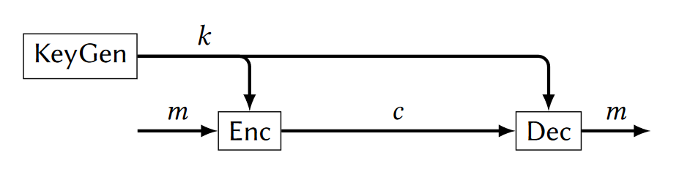
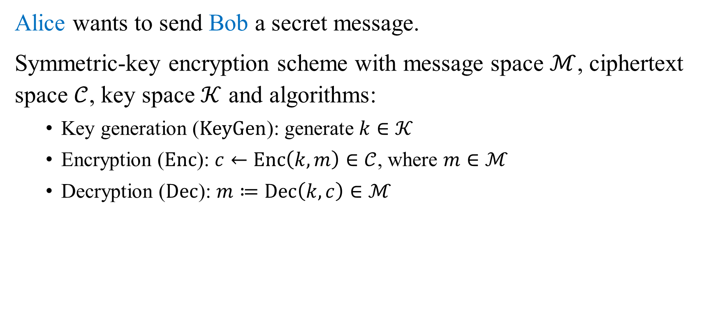
Encryption Scheme
Alice wants to send Bob a secret message.
Symmetric-key encryption scheme with message space $ℳ$, ciphertext space $𝒞$, key space $𝒦$ and algorithms:
Key generation ($KeyGen$): generate $k∈𝒦$
Encryption ($Enc$): $c←Enc\left(k,m\right)∈𝒞$, where $m∈ℳ$
Decryption ($Dec$): $m≔Dec\left(k,c\right)∈ℳ$

Slide 27

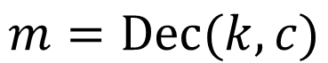
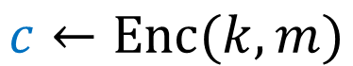
Encryption Scheme
Alice wants to send Bob a secret message.
$$c←Enc(k,m)$$
$$m=Dec(k,c)$$
Eve
(eavesdropper)

Slide 28
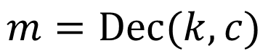
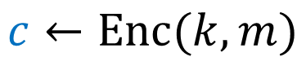
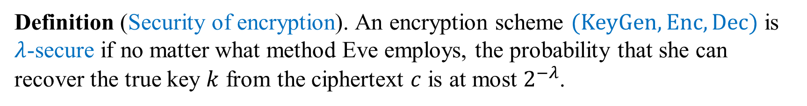
Secure Encryption?
Alice wants to send Bob a secret message.
$$c←Enc(k,m)$$
$$m=Dec(k,c)$$
Eve
(eavesdropper)
Definition (Security of encryption). An encryption scheme $(KeyGen,Enc, Dec)$ is $λ$-secure if no matter what method Eve employs, the probability that she can recover the true key $k$ from the ciphertext $c$ is at most $2^{−λ}$.

Slide 29
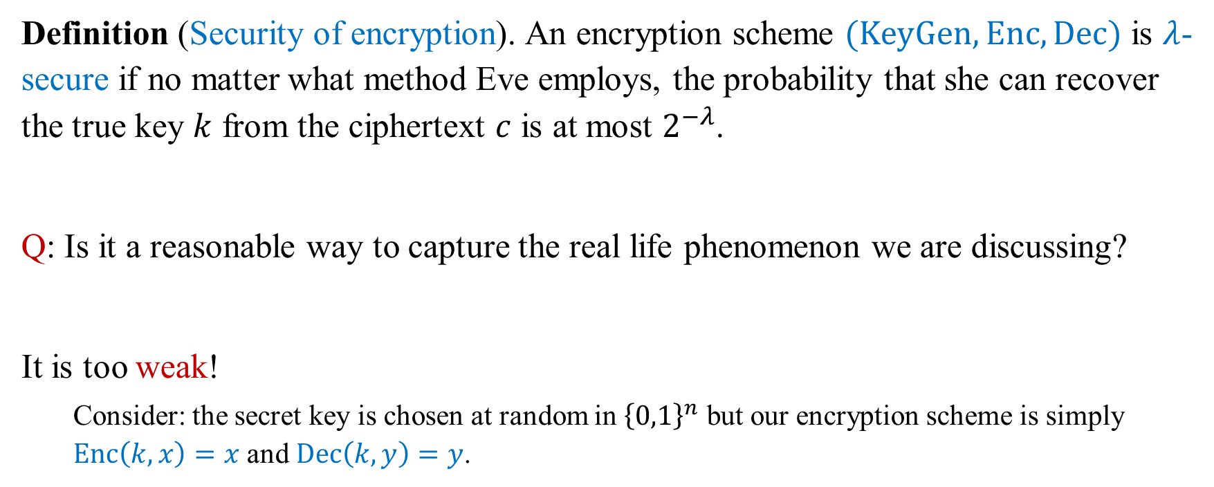
Secure Encryption?
Definition (Security of encryption). An encryption scheme $(KeyGen,Enc, Dec)$ is $λ$-secure if no matter what method Eve employs, the probability that she can recover the true key $k$ from the ciphertext $c$ is at most $2^{−λ}$.
Q: Is it a reasonable way to capture the real life phenomenon we are discussing?
It is too weak!
Consider: the secret key is chosen at random in ${\left\{0,1\right\}}^{n}$ but our encryption scheme is simply $Enc\left(k,x\right)=x$ and $Dec\left(k,y\right)=y$.

Slide 30
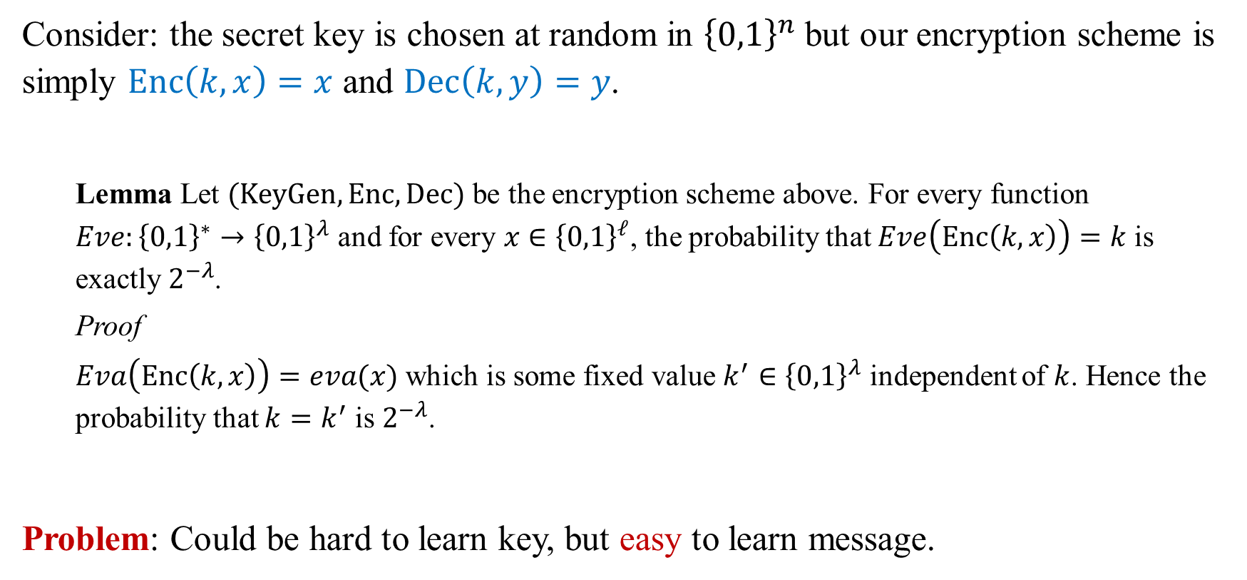
Secure Encryption?
Consider: the secret key is chosen at random in ${\left\{0,1\right\}}^{n}$ but our encryption scheme is simply $Enc\left(k,x\right)=x$ and $Dec\left(k,y\right)=y$.
Lemma Let $(KeyGen,Enc, Dec)$ be the encryption scheme above. For every function $Eve:{\left\{0,1\right\}}^{∗}→{\left\{0,1\right\}}^{λ}$ and for every $x∈{\left\{0,1\right\}}^{ℓ}$, the probability that $Eve\left(Enc\left(k,x\right)\right)=k$ is exactly $2^{−λ}$.
Proof
$Eva\left(Enc\left(k,x\right)\right)=eva(x)$ which is some fixed value $k^{′}∈{\left\{0,1\right\}}^{λ}$ independent of $k$. Hence the probability that $k=k^{′}$ is $2^{−λ}$.
Problem: Could be hard to learn key, but easy to learn message.

Slide 31
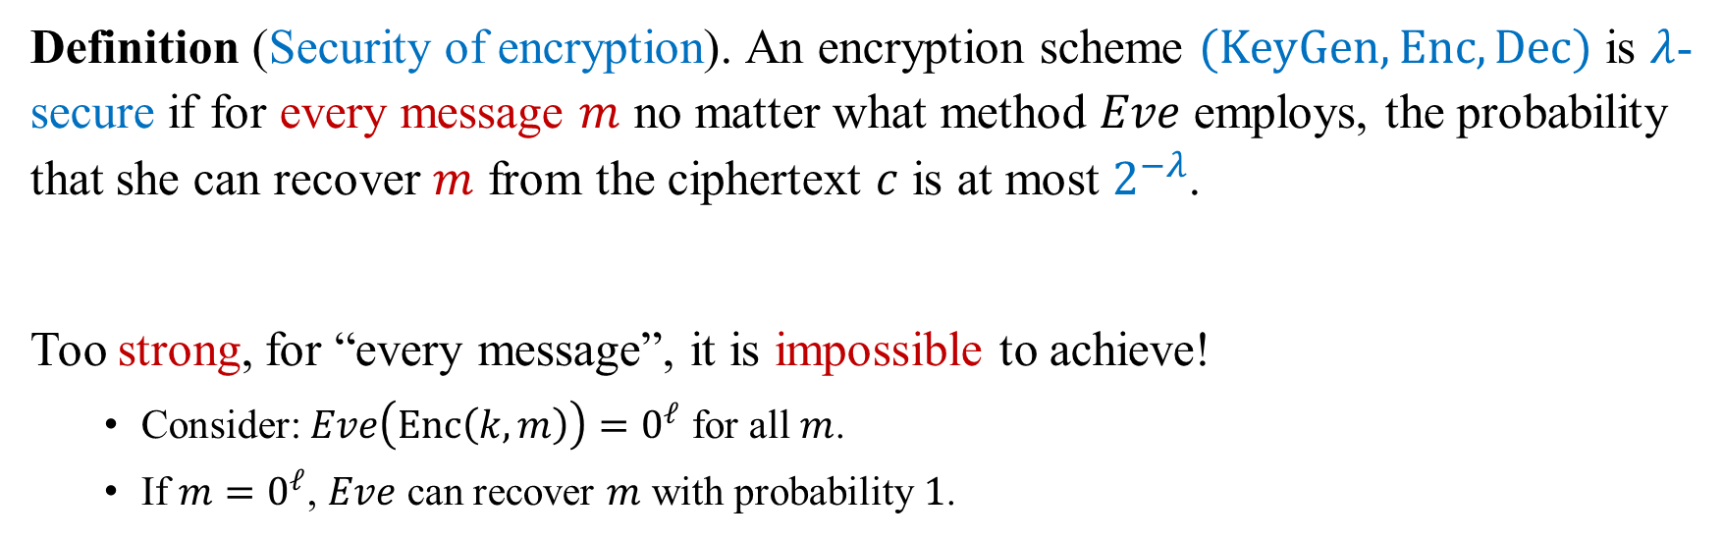
Secure Encryption?
Definition (Security of encryption). An encryption scheme $(KeyGen,Enc, Dec)$ is $λ$-secure if for every message $m$ no matter what method $Eve$ employs, the probability that she can recover $m$ from the ciphertext $c$ is at most $2^{−λ}$.
Too strong, for “every message”, it is impossible to achieve!
Consider: $Eve\left(Enc\left(k,m\right)\right)=0^{ℓ}$ for all $m$.
If $m=0^{ℓ}$, $Eve$ can recover $m$ with probability $1$.

Slide 32
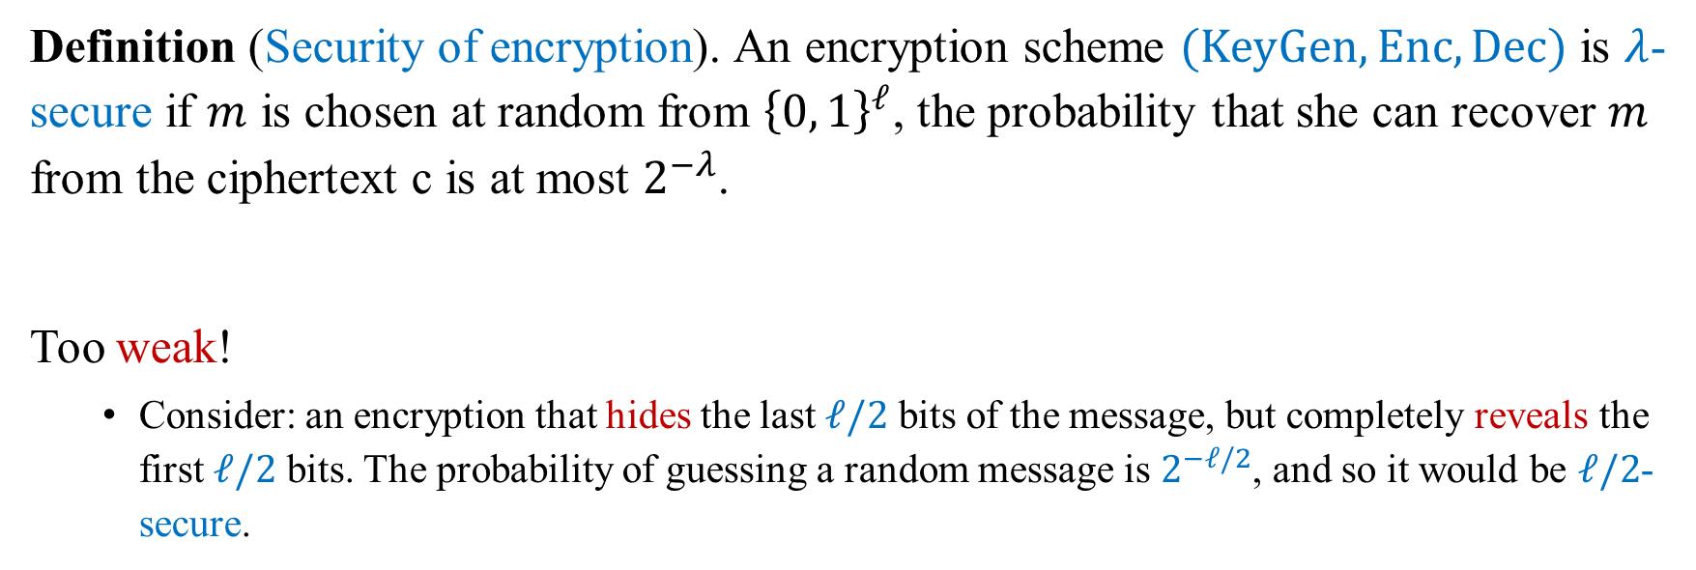
Secure Encryption?
Definition (Security of encryption). An encryption scheme $(KeyGen,Enc, Dec)$ is $λ$-secure if $m$ is chosen at random from ${\left\{0, 1\right\}}^{ℓ}$, the probability that she can recover $m$ from the ciphertext c is at most $2^{−λ}$.
Too weak!
Consider: an encryption that hides the last $ℓ/2$ bits of the message, but completely reveals the first $ℓ/2$ bits. The probability of guessing a random message is $2^{−ℓ/2}$, and so it would be $ℓ/2$-secure.

Slide 33
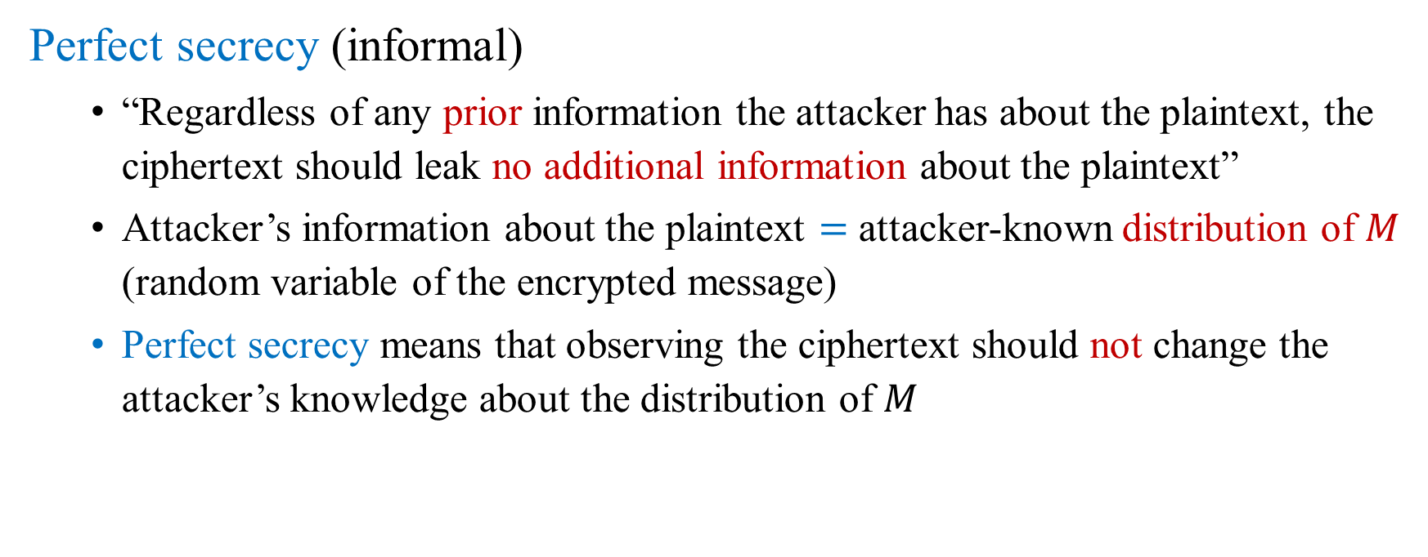
Secure Encryption?
Perfect secrecy (informal)
“Regardless of any prior information the attacker has about the plaintext, the ciphertext should leak no additional information about the plaintext”
Attacker’s information about the plaintext $=$ attacker-known distribution of $M$ (random variable of the encrypted message)
Perfect secrecy means that observing the ciphertext should not change the attacker’s knowledge about the distribution of $M$

Slide 34
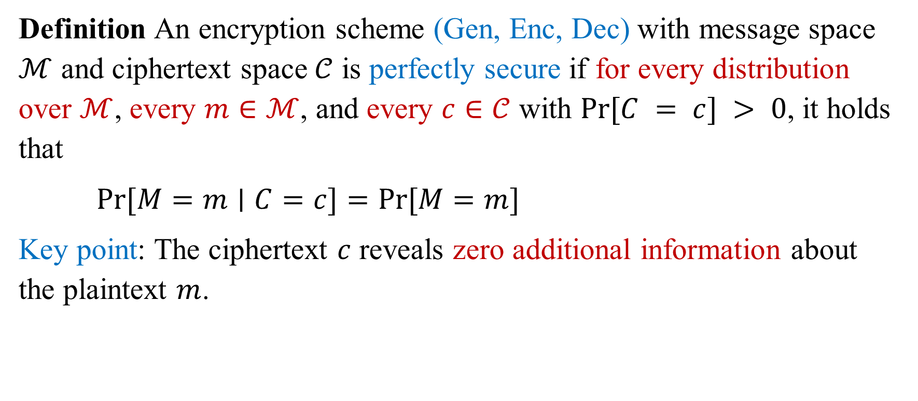
Perfect Secrecy
Definition An encryption scheme (Gen, Enc, Dec) with message space $ℳ$ and ciphertext space $𝒞$ is perfectly secure if for every distribution over $ℳ$, every $m∈ℳ$, and every $c∈𝒞$ with $Pr⁡[C = c] > 0$, it holds that
$Pr⁡[M=m∣C=c]=Pr⁡[M=m]$
Key point: The ciphertext $c$ reveals zero additional information about the plaintext $m$.

Slide 35
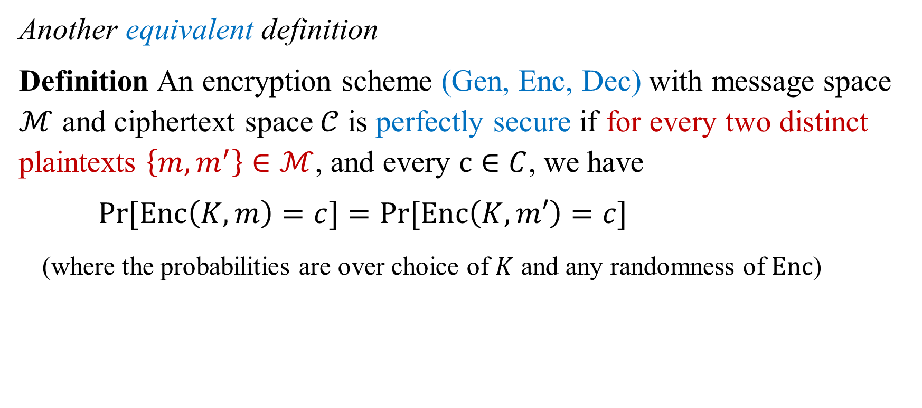
Perfect Secrecy
Another equivalent definition
Definition An encryption scheme (Gen, Enc, Dec) with message space $ℳ$ and ciphertext space $𝒞$ is perfectly secure if for every two distinct plaintexts $\left\{m, m^{′}\right\}∈ℳ$, and every $c∈C$, we have
$\operatorname{Pr}{[Enc\left(K,m\right)=c]}=\operatorname{Pr}{[Enc\left(K,m′\right)=c]}$
(where the probabilities are over choice of $K$ and any randomness of $Enc$)

Slide 36
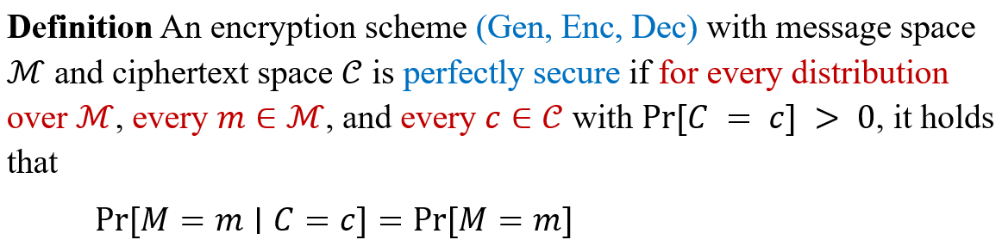
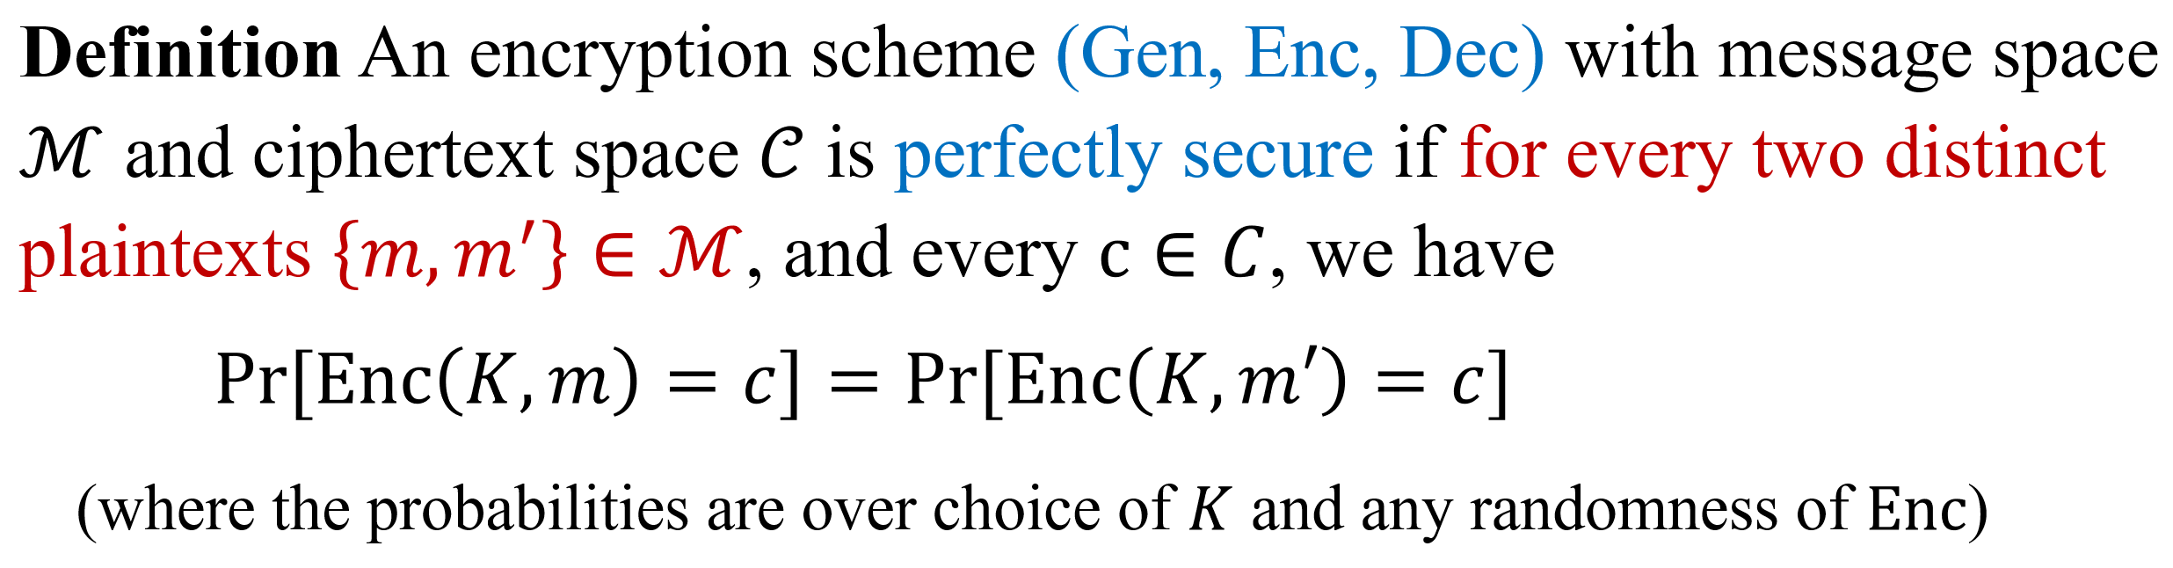
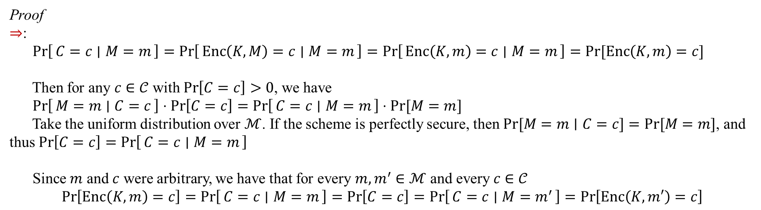
Perfect Secrecy
Proof
$⇒$:
$\operatorname{Pr}\left[C=c ∣ M=m\right]=\operatorname{Pr}\left[Enc\left(K,M\right)=c ∣ M=m\right]=\operatorname{Pr}\left[Enc\left(K,m\right)=c ∣ M=m\right]=Pr⁡[Enc\left(K,m\right)=c]$
Then for any $c∈𝒞$ with $\operatorname{Pr}\left[C=c\right]>0$, we have
$\operatorname{Pr}\left[M=m ∣ C=c\right]⋅\operatorname{Pr}\left[C=c\right]=\operatorname{Pr}\left[C=c ∣ M=m\right]⋅Pr⁡[M=m]$
Take the uniform distribution over $ℳ$. If the scheme is perfectly secure, then $Pr⁡[M=m∣C=c]=Pr⁡[M=m]$, and thus $\operatorname{Pr}\left[C=c\right]=\operatorname{Pr}\left[C=c ∣ M=m\right]$
Since $m$ and $c$ were arbitrary, we have that for every $m,m^{′}∈ℳ$ and every $c∈𝒞$
$$\operatorname{Pr}\left[Enc\left(K,m\right)=c\right]=\operatorname{Pr}\left[C=c ∣ M=m\right]=\operatorname{Pr}\left[C=c\right]=\operatorname{Pr}\left[C=c ∣ M=m^{′}\right]=\operatorname{Pr}\left[Enc\left(K,m′\right)=c\right]$$

Slide 37
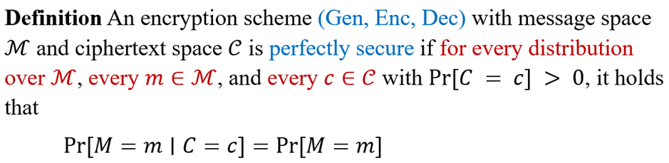
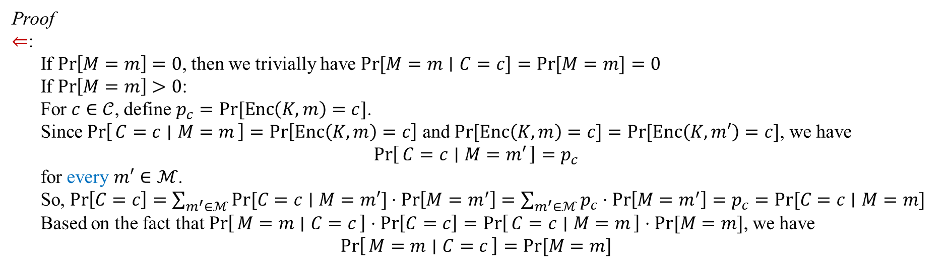
Perfect Secrecy
Proof
$⇐$:
If $\operatorname{Pr}\left[M=m\right]=0$, then we trivially have $\operatorname{Pr}{[M=m∣C=c]}=\operatorname{Pr}{[M=m]}=0$
If $\operatorname{Pr}\left[M=m\right]>0$:
For $c∈𝒞$, define $p_{c}=Pr⁡[Enc\left(K,m\right)=c]$.
Since $\operatorname{Pr}\left[C=c ∣ M=m\right]=\operatorname{Pr}\left[Enc\left(K,m\right)=c\right]$ and $\operatorname{Pr}{[Enc\left(K,m\right)=c]}=\operatorname{Pr}{[Enc\left(K,m′\right)=c]}$, we have
$$\operatorname{Pr}\left[C=c ∣ M=m′\right]=p_{c}$$
for every $m′∈ℳ$.
So, $\operatorname{Pr}\left[C=c\right]=\sum_{m^{′}∈ℳ}{Pr⁡[C=c∣M=m′]}⋅\operatorname{Pr}\left[M=m^{′}\right]=\sum_{m^{′}∈ℳ}{p_{c}⋅\operatorname{Pr}\left[M=m^{′}\right]}=p_{c}=Pr⁡[C=c∣M=m]$
Based on the fact that $\operatorname{Pr}\left[M=m ∣ C=c\right]⋅\operatorname{Pr}\left[C=c\right]=\operatorname{Pr}\left[C=c ∣ M=m\right]⋅Pr⁡[M=m]$, we have
$$\operatorname{Pr}\left[M=m ∣ C=c\right]=Pr⁡[M=m]$$

Slide 38
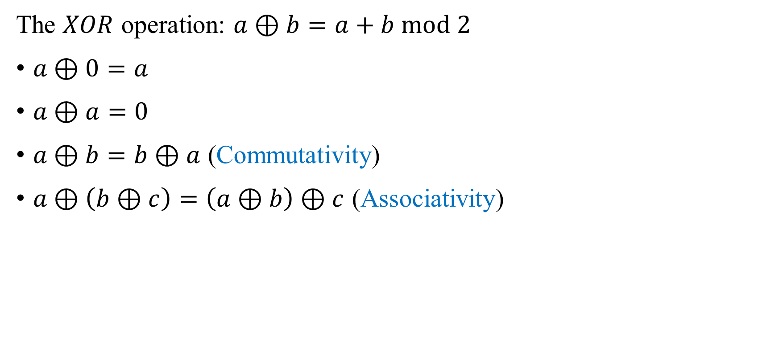
Achieving Perfect Secrecy
The $XOR$ operation: $a⊕b=a+b mod 2$
$a⊕0=a$
$a⊕a=0$
$a⊕b=b⊕a$ (Commutativity)
$a⊕\left(b⊕c\right)=\left(a⊕b\right)⊕c$ (Associativity)

Slide 39
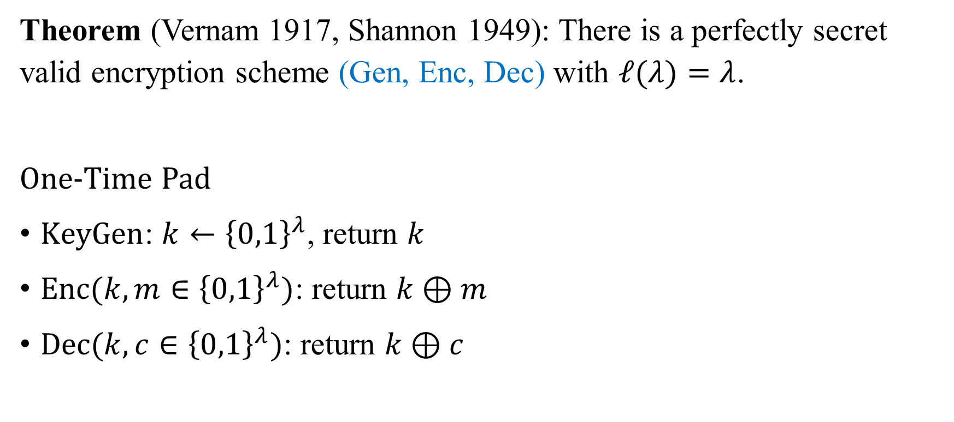
Achieving Perfect Secrecy
Theorem (Vernam 1917, Shannon 1949): There is a perfectly secret valid encryption scheme (Gen, Enc, Dec) with $ℓ(λ)=λ$.
One-Time Pad
$KeyGen$: $k←{\left\{0,1\right\}}^{λ}$, return $k$
$Enc(k,m∈{\left\{0,1\right\}}^{λ})$: return $k⊕m$
$Dec(k, c∈{\left\{0,1\right\}}^{λ})$: return $k⊕c$

Slide 40
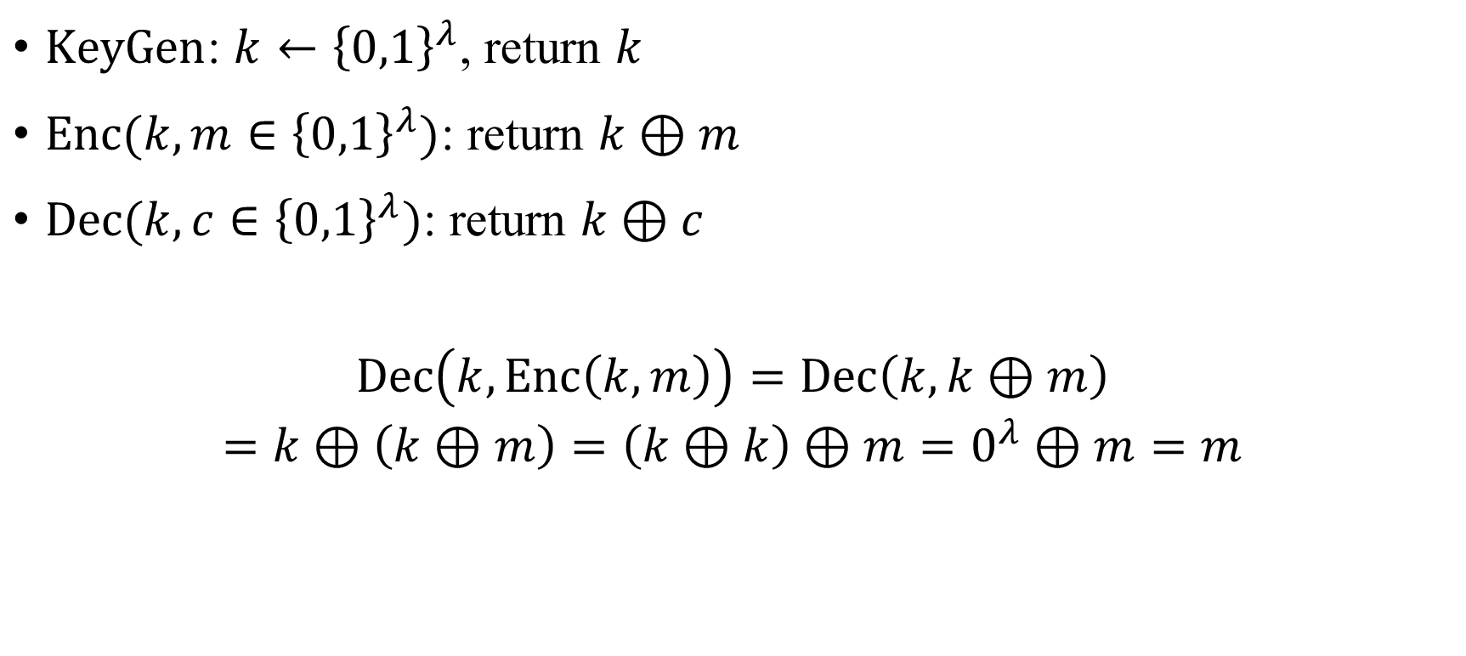
One-Time Pad - Correctness
$KeyGen$: $k←{\left\{0,1\right\}}^{λ}$, return $k$
$Enc(k,m∈{\left\{0,1\right\}}^{λ})$: return $k⊕m$
$Dec(k, c∈{\left\{0,1\right\}}^{λ})$: return $k⊕c$
$$Dec\left(k, Enc\left(k,m\right)\right)=Dec\left(k,k⊕m\right)$$
$$=k⊕\left(k⊕m\right)=\left(k⊕k\right)⊕m=0^{λ}⊕m=m$$

Slide 41
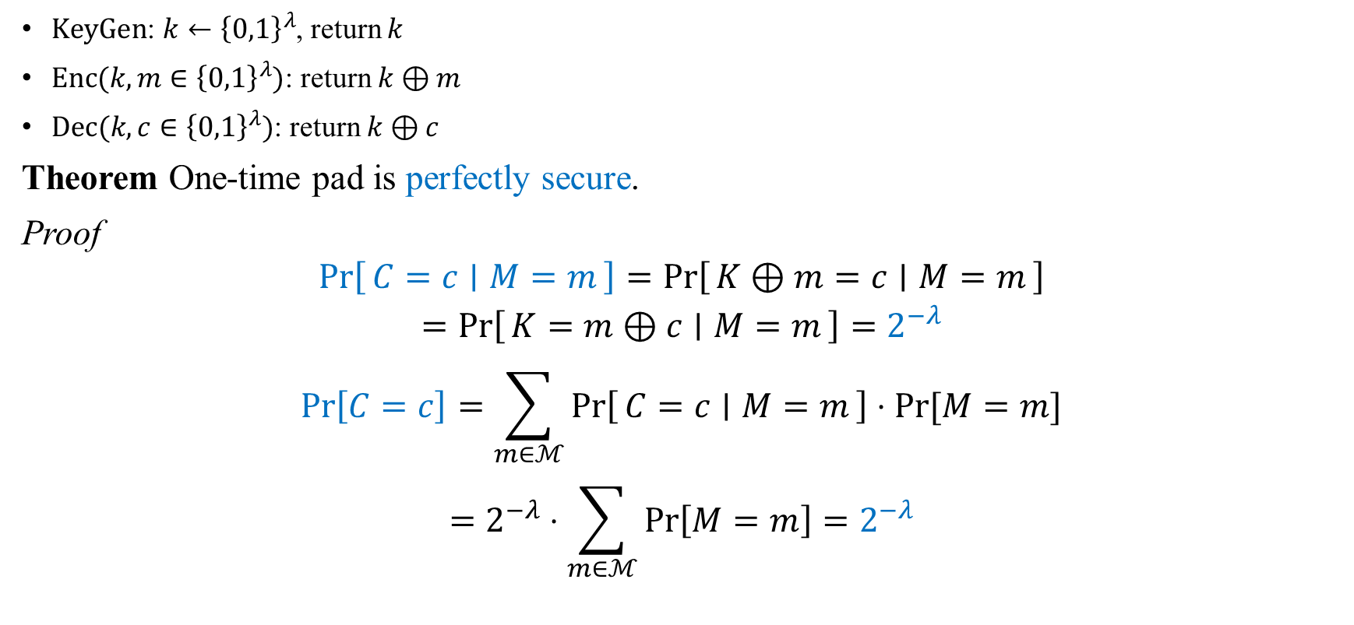
One-Time Pad - Security
$KeyGen$: $k←{\left\{0,1\right\}}^{λ}$, return $k$
$Enc(k,m∈{\left\{0,1\right\}}^{λ})$: return $k⊕m$
$Dec(k, c∈{\left\{0,1\right\}}^{λ})$: return $k⊕c$
Theorem One-time pad is perfectly secure.
Proof
$$\operatorname{Pr}\left[C=c ∣ M=m\right]=\operatorname{Pr}\left[K⊕m=c ∣ M=m\right]$$
$$=\operatorname{Pr}\left[K=m⊕c ∣ M=m\right]=2^{−λ}$$
$$\operatorname{Pr}\left[C=c\right]=\sum_{m∈ℳ}{\operatorname{Pr}\left[C=c ∣ M=m\right]⋅Pr⁡[M=m]}$$
$$=2^{−λ}⋅\sum_{m∈ℳ}{\operatorname{Pr}\left[M=m\right]}=2^{−λ}$$

Slide 42
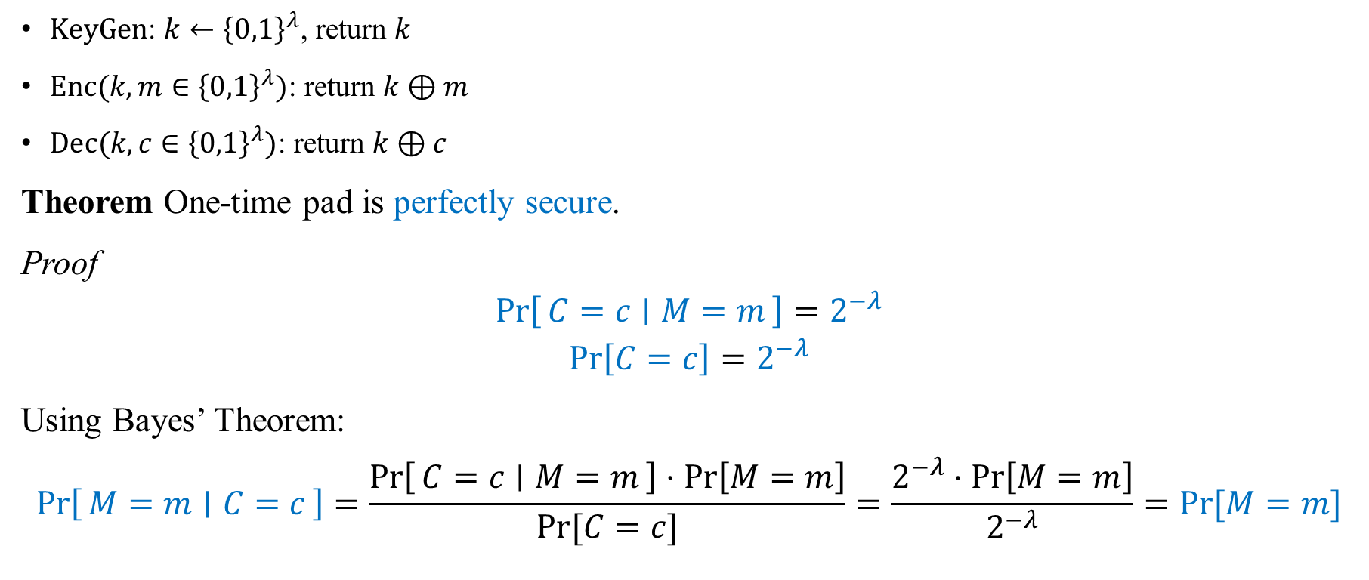
One-Time Pad - Security
$KeyGen$: $k←{\left\{0,1\right\}}^{λ}$, return $k$
$Enc(k,m∈{\left\{0,1\right\}}^{λ})$: return $k⊕m$
$Dec(k, c∈{\left\{0,1\right\}}^{λ})$: return $k⊕c$
Theorem One-time pad is perfectly secure.
Proof
$$\operatorname{Pr}\left[C=c ∣ M=m\right]=2^{−λ}$$
$$\operatorname{Pr}\left[C=c\right]=2^{−λ}$$
Using Bayes’ Theorem:
$$\operatorname{Pr}\left[M=m ∣ C=c\right]=\frac{\operatorname{Pr}\left[C=c ∣ M=m\right]⋅\operatorname{Pr}\left[M=m\right]}{Pr⁡[C=c]}=\frac{2^{−λ}⋅\operatorname{Pr}\left[M=m\right]}{2^{−λ}}=Pr⁡[M=m]$$

Slide 43
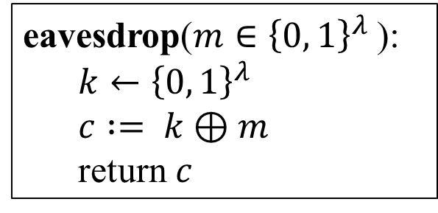
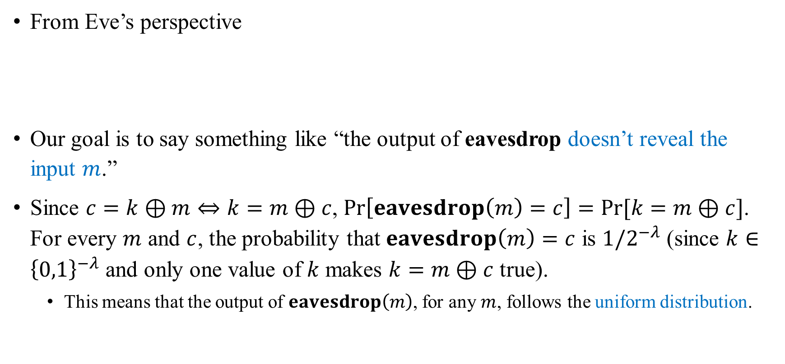
Another Perspective
From Eve’s perspective
Our goal is to say something like “the output of eavesdrop doesn’t reveal the input $m$.”
Since $c=k⊕m⇔k=m⊕c$, $\operatorname{Pr}\left[eavesdrop\left(m\right)=c\right]=Pr⁡[k=m⊕c]$. For every $m$ and $c$, the probability that $eavesdrop\left(m\right)=c$ is $1/2^{−λ}$ (since $k∈{\left\{0,1\right\}}^{−λ}$ and only one value of $k$ makes $k=m⊕c$ true).
This means that the output of $eavesdrop\left(m\right)$, for any $m$, follows the uniform distribution.
eavesdrop($m∈{\left\{0, 1\right\}}^{λ}$):
$k←{\left\{0, 1\right\}}^{λ}$
$c := k⊕m$
return $c$

Slide 44
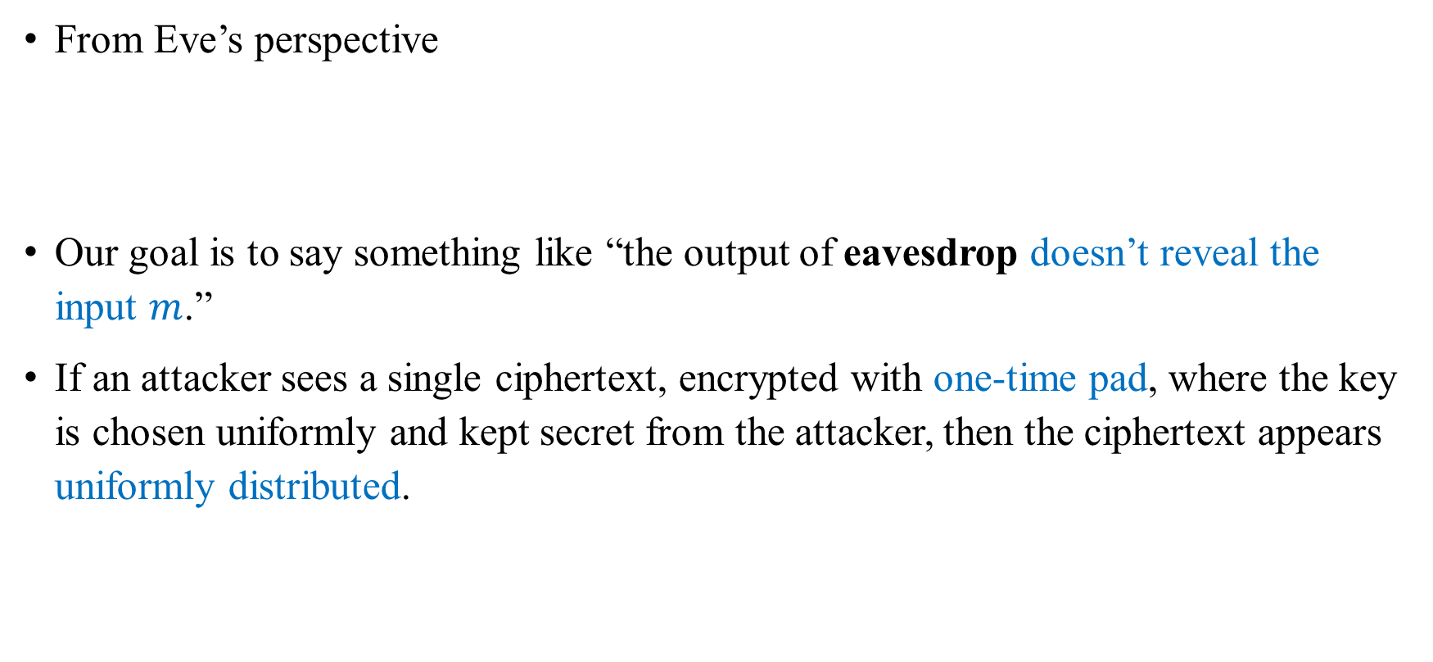
Another Perspective
From Eve’s perspective
Our goal is to say something like “the output of eavesdrop doesn’t reveal the input $m$.”
If an attacker sees a single ciphertext, encrypted with one-time pad, where the key is chosen uniformly and kept secret from the attacker, then the ciphertext appears uniformly distributed.
eavesdrop($m∈{\left\{0, 1\right\}}^{λ}$):
$k←{\left\{0, 1\right\}}^{λ}$
$c := k⊕m$
return $c$

Slide 45
Key Generation
When describing algorithms, we assume access to uniformly distributed bits/bytes. Where do these actually come from?
Precise details depend on the system
Linux or unix: /dev/random or /dev/urandom
Do not use rand() or java.util.Random
Use crypto libraries instead

Slide 46
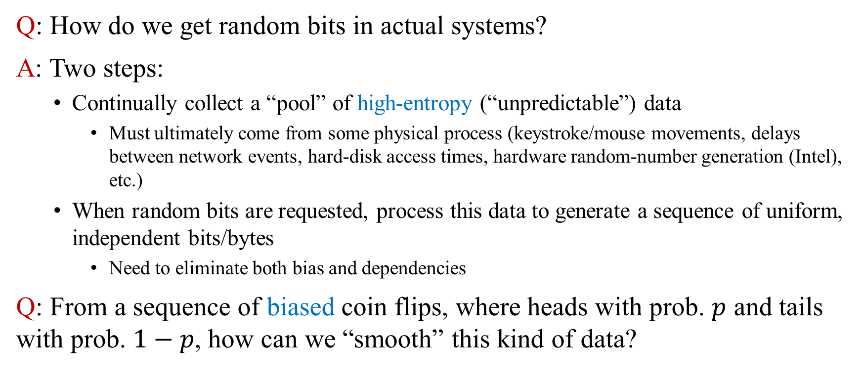
Generating Randomness
Q: How do we get random bits in actual systems?
A: Two steps:
Continually collect a “pool” of high-entropy (“unpredictable”) data
Must ultimately come from some physical process (keystroke/mouse movements, delays between network events, hard-disk access times, hardware random-number generation (Intel), etc.)
When random bits are requested, process this data to generate a sequence of uniform, independent bits/bytes
Need to eliminate both bias and dependencies
Q: From a sequence of biased coin flips, where heads with prob. $p$ and tails with prob. $1−p$, how can we “smooth” this kind of data?

Slide 47
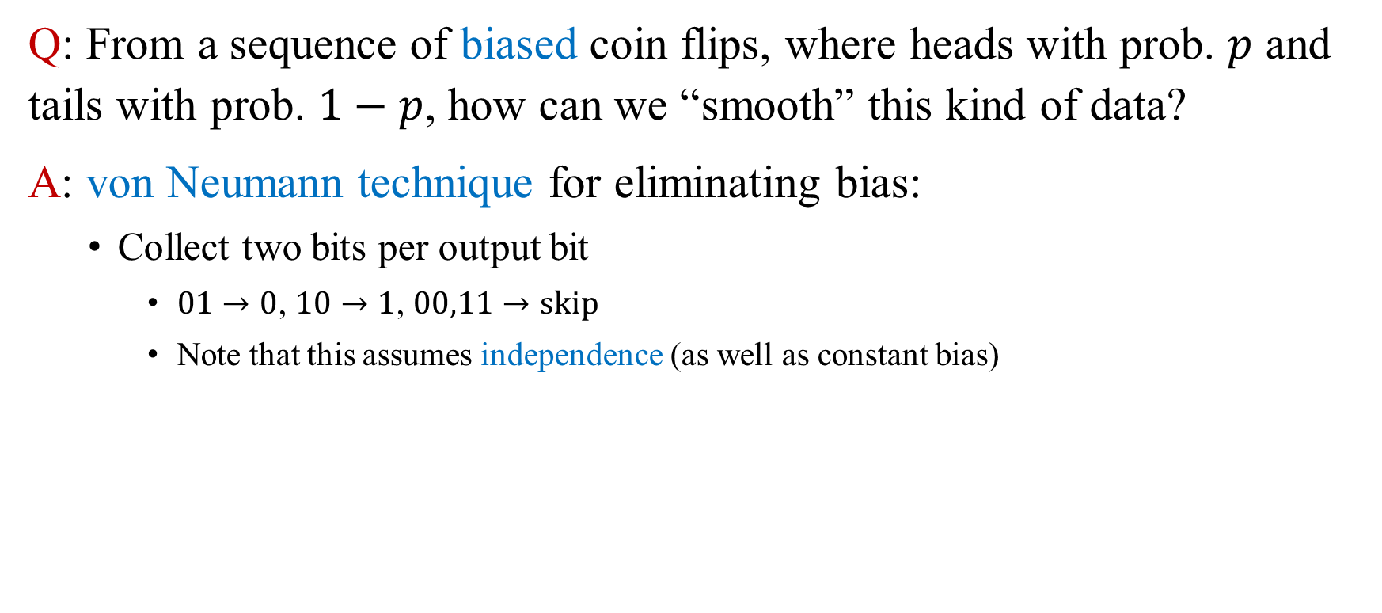
Generating Randomness
Q: From a sequence of biased coin flips, where heads with prob. $p$ and tails with prob. $1−p$, how can we “smooth” this kind of data?
A: von Neumann technique for eliminating bias:
Collect two bits per output bit
$01→0$, $10→1$, $00,11→skip$
Note that this assumes independence (as well as constant bias)

Slide 48
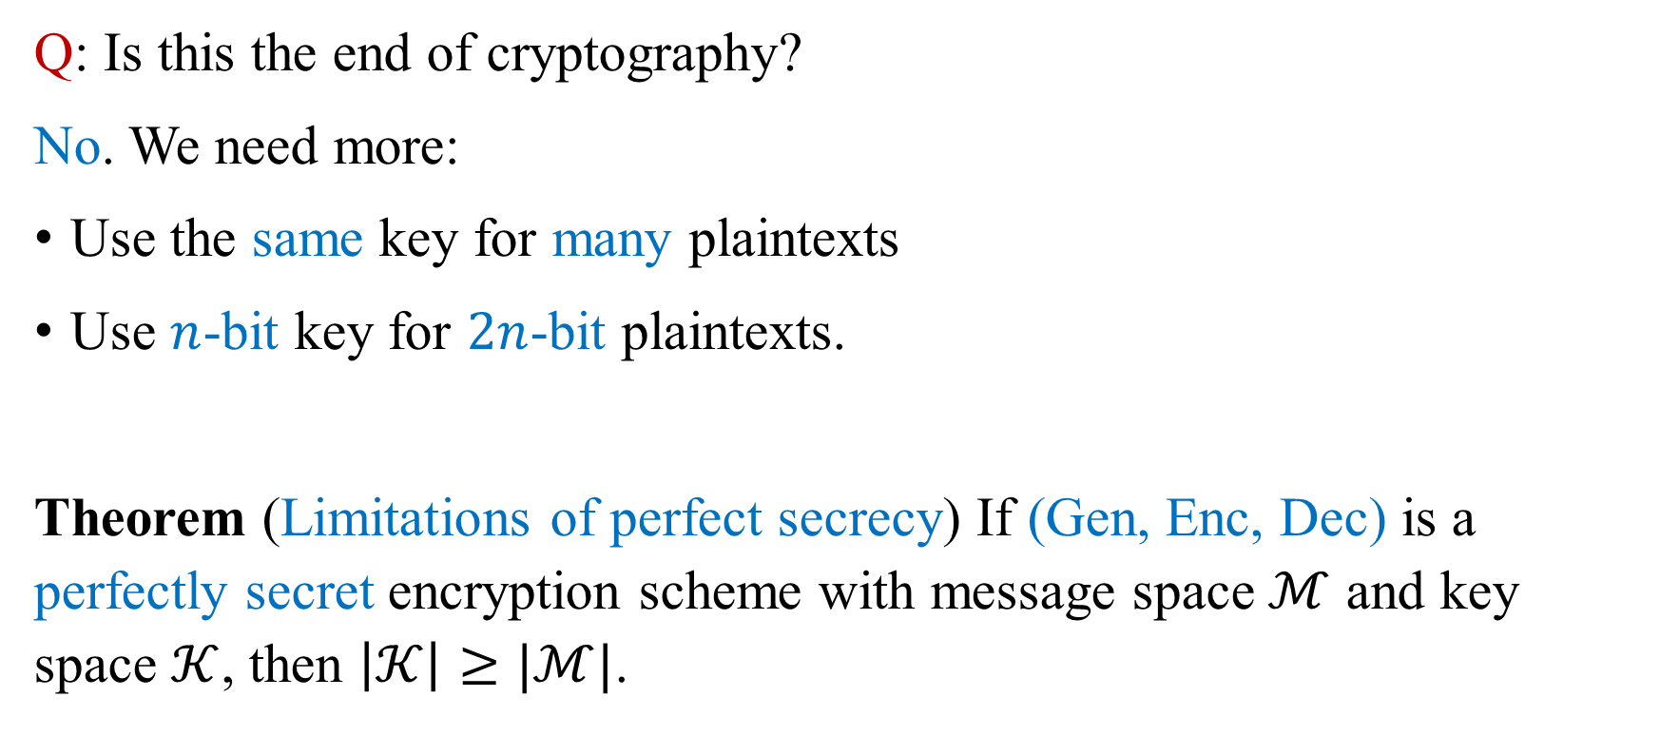
One-Time Pad
Q: Is this the end of cryptography?
No. We need more:
Use the same key for many plaintexts
Use $n$-bit key for $2n$-bit plaintexts.
Theorem (Limitations of perfect secrecy) If (Gen, Enc, Dec) is a perfectly secret encryption scheme with message space $ℳ$ and key space $𝒦$, then $\left|𝒦\right|≥|ℳ|$.

Slide 49
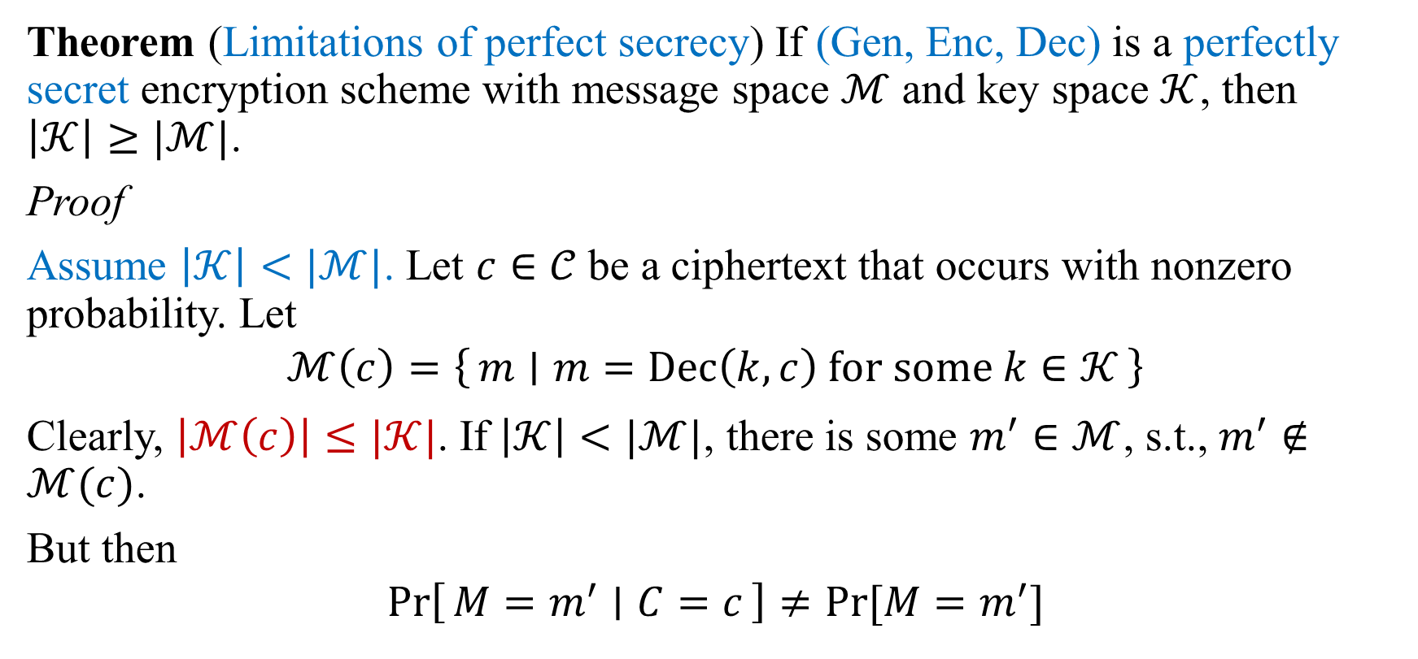
Limitations of Perfect Secrecy
Theorem (Limitations of perfect secrecy) If (Gen, Enc, Dec) is a perfectly secret encryption scheme with message space $ℳ$ and key space $𝒦$, then $\left|𝒦\right|≥|ℳ|$.
Proof
Assume $\left|𝒦\right|<|ℳ|$. Let $c∈𝒞$ be a ciphertext that occurs with nonzero probability. Let
$$ℳ\left(c\right)=\left\{m ∣ m=Dec\left(k,c\right) for some k∈𝒦\right\}$$
Clearly, $\left|ℳ\left(c\right)\right|≤|𝒦|$. If $\left|𝒦\right|<|ℳ|$, there is some $m^{′}∈ℳ$, s.t., $m^{′}∉ℳ(c)$.
But then
$$\operatorname{Pr}\left[M=m^{′} ∣ C=c\right]≠Pr⁡[M=m^{′}]$$

Slide 50
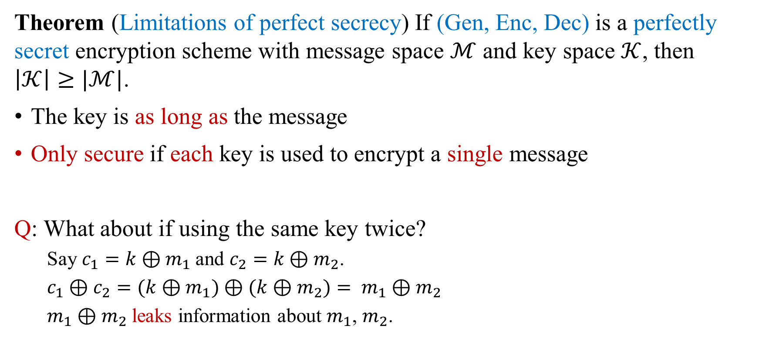
Limitations of Perfect Secrecy
Theorem (Limitations of perfect secrecy) If (Gen, Enc, Dec) is a perfectly secret encryption scheme with message space $ℳ$ and key space $𝒦$, then $\left|𝒦\right|≥|ℳ|$.
The key is as long as the message
Only secure if each key is used to encrypt a single message
Q: What about if using the same key twice?
Say $c_{1}=k⊕m_{1}$and $c_{2}=k⊕m_{2}$.
$c_{1}⊕c_{2}=(k⊕m_{1})⊕(k⊕m_{2})= m_{1}⊕m_{2}$
$m_{1}⊕m_{2}$ leaks information about $m_{1}$, $m_{2}$.

Slide 51
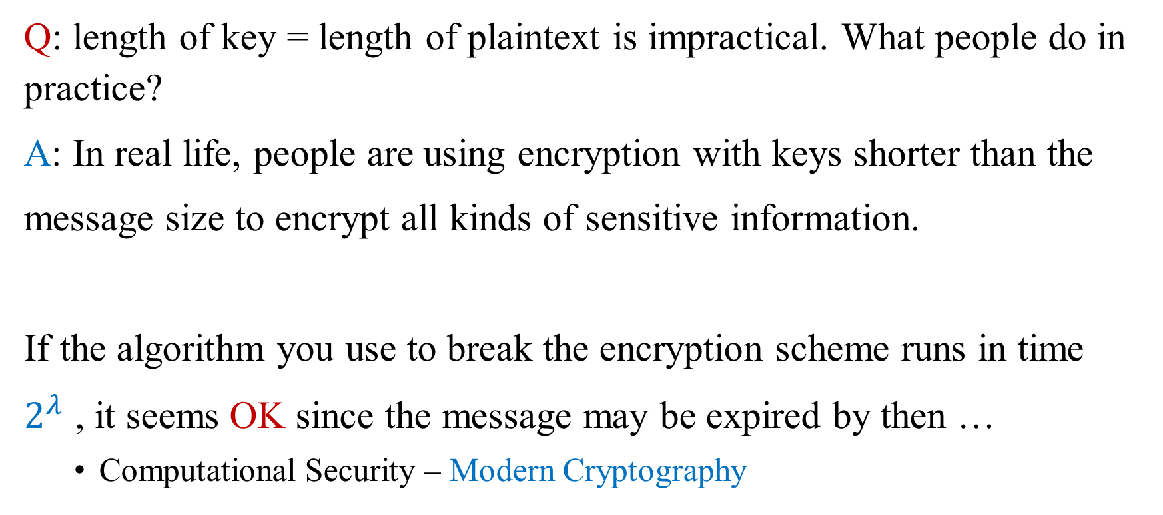
Limitations of Perfect Secrecy
Q: length of key = length of plaintext is impractical. What people do in practice?
A: In real life, people are using encryption with keys shorter than the
message size to encrypt all kinds of sensitive information.
If the algorithm you use to break the encryption scheme runs in time
$2^{λ}$ , it seems OK since the message may be expired by then …
Computational Security – Modern Cryptography

Slide 52
Principles of Modern Cryptography
Principle 1: Formal Definitions
Principle 2: Precise Assumptions
Principle 3: Proofs of Security

Slide 53
Importance of Definitions
Definitions are essential for the design, analysis, and usage of crypto
Security guarantee/goal
What we want to achieve and/or what we want to prevent the attacker from achieving
Threat model
What (real-world) capabilities the attacker is assumed to have

Slide 54
Importance of Definitions - Design
Developing a precise definition forces the designer to think about what they really want
What is essential and (sometimes more important) what is not
Often reveals subtleties of the problem
If you don’t understand what you want to achieve, how can you possibly know when (or if) you have achieved it?

Slide 55
Importance of Definitions - Analysis
Definitions enable meaningful analysis, evaluation, and comparison of schemes
Does a scheme satisfy the definition?
What definition does it satisfy?
One scheme may be less efficient than another, yet satisfy a stronger security definition.

Slide 56
Importance of Definitions - Usage
Definitions allow to understand the security guarantees provided by a scheme
Enable schemes to be used as components of a larger system (modularity)
Enables one scheme to be substituted for another if they satisfy the same definition

Slide 57
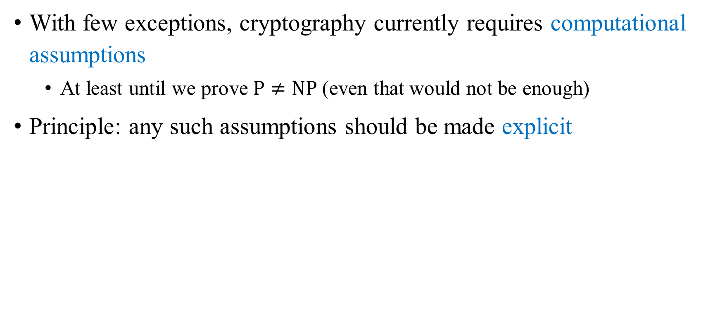
Assumptions
With few exceptions, cryptography currently requires computational assumptions
At least until we prove $P≠NP$(even that would not be enough)
Principle: any such assumptions should be made explicit

Slide 58
Importance of Clear Assumptions
Allow researchers to (attempt to) validate assumptions by studying them
Allow meaningful comparison between schemes based on different assumptions
Useful to understand minimal assumptions needed
Practical implications if assumptions are wrong
Enable proofs of security

Slide 59
Proofs of Security
Provide a rigorous proof that a construction satisfies a given definition under certain specified assumptions
Proofs are crucial in crypto, where there is a malicious attacker trying to “break” the scheme

Slide 60
Limitations?
Provably secure schemes can be broken!
If the definition does not correspond to the real-world threat model
If the assumption is invalid
If the implementation is flawed

Slide 61
The Basic of Provable Security

Slide 62
Provable Security
“Human ingenuity cannot concoct a cipher which human ingenuity cannot resolve.” by Edgar Allan Poe
This was an accurate assessment of the cryptography that existed in 1841.
cat-and-mouse game
Modern 21st-century cryptography, however, is different.
The code-makers can win against the code-breakers.
Prove the security!

Slide 63
How to Write a Security Definition
A security definition should give guarantees about what can happen to a system in the presence of an attacker.
But, not all important properties of a system refer to an attacker.
We don’t reference any attacker when we say that the Enc algorithm takes two arguments (a key and a plaintext), or that the KeyGen algorithm takes no arguments. We call these properties the syntax of the scheme.
Even if there is no attacker, it’s still important that decryption is an inverse of encryption. This is not a security property of the encryption scheme. Instead, we call it a correctness property.
Security definitions always consider the attacker’s view of the system.

Slide 64

Encryption - Syntax
A symmetric-key encryption (SKE) scheme consists of the following algorithms:
KeyGen: a randomized algorithm that outputs a key $k∈𝒦$.
Enc: a (possibly randomized) algorithm that takes a key $k∈𝒦$ and plaintext $m∈ℳ$ as input, and outputs a ciphertext $c∈𝒞$.
Dec: a deterministic algorithm that takes a key $k∈𝒦$and ciphertext $c∈𝒞$ as input, and outputs a plaintext $m∈ℳ$.

Slide 65

Encryption - Correctness
An encryption scheme $Σ$ satisfies correctness if for all $k∈Σ.𝒦$ and all $m∈Σ.ℳ$,
$$\operatorname{Pr}\left[Σ. Dec\left(k, Σ. Enc\left(k, m\right)\right)=m\right]=1$$
A scheme defined by $Enc(k, m) = m$and Dec(k, c) = c
does satisfy the correctness property
would not satisfy any reasonable security property

Slide 66
“Real-vs-Random” Style of Security Definition
An intuitive idea
“an encryption scheme is a good one if its ciphertexts look like random junk to an attacker.”
Key is kept secret from the attacker.
Consider the scheme where the key is used to encrypt one plaintext
Will consider one-key-many-plaintexts case later
Plaintext is chosen by the attacker
A “pessimistic” choice: give much power to the attacker
If a scheme is secure when the attacker chooses the plaintext, then it should be secure in more realistic scenarios where the attacker has some uncertainty about the plaintexts.

Slide 67


“Real-vs-Random” Style of Security Definition
An intuitive idea
“an encryption scheme is a good one if its ciphertexts look like random junk to an attacker . . . when each key is secret and used to encrypt only one plaintext, even when the attacker chooses the plaintexts.”
How to express these details?
Consider: the attacker is a calling program to the following subroutine.
ctxt($m∈Σ. ℳ$):
$$k←Σ.KeyGen$$
$$c := Σ.Enc(k, m)$$
return $c$
ctxt($m∈Σ. ℳ$):
$c ← Σ. 𝒞$
return c
Vs.

Slide 68


“Real-vs-Random” Style of Security Definition
Consider: the attacker is a calling program to the following subroutines.
No calling program should have any way of determining which of these two implementations is answering subroutine calls.
“an encryption scheme is a good one if, when you plug its KeyGen and Enc algorithms into the template of the ctxt subroutine above, the two implementations of ctxt induce identical behavior in every calling program.”
ctxt($m∈Σ. ℳ$):
$$k←Σ.KeyGen$$
$$c := Σ.Enc(k, m)$$
return $c$
ctxt($m∈Σ. ℳ$):
$c ← Σ. 𝒞$
return c
Vs.

Slide 69


“Real-vs-Random” Style of Security Definition
One-time pad satisfies the new security property
ctxt($m$):
$k←{\left\{0,1\right\}}^{λ}$
$c :=k⊕m$
return $c$
ctxt($m$):
$c ←{\left\{0,1\right\}}^{λ}$
return c
Vs.

Slide 70



“Left-vs-Right” Style of Security Definition
An intuitive idea
“an encryption scheme is a good one if encryptions of $m_{L}$ look like encryptions
of $m_{R}$ to an attacker when each key is secret and used to encrypt only one plaintext, even when the attacker chooses $m_{L}$ and $m_{R}$.”
How to express these details?
Consider: the attacker is a calling program to the following subroutine.
eavesdrop($m_{L},m_{R}∈Σ. ℳ$):
$k←Σ.KeyGen$
$c := Σ.Enc(k, m_{L})$
return $c$
eavesdrop($m_{L},m_{R}∈Σ. ℳ$):
$k←Σ.KeyGen$
$c := Σ.Enc(k, m_{R})$
return $c$
Vs.

Slide 71


“Left-vs-Right” Style of Security Definition
Consider: the attacker is a calling program to the following subroutines.
No calling program should have any way of determining which of these two implementations is answering subroutine calls.
“an encryption scheme is a good one if, when you plug its KeyGen and Enc algorithms into the template of the eavesdrop subroutine above, the two implementations of eavesdrop induce identical behavior in every calling program.”
eavesdrop($m_{L},m_{R}∈Σ. ℳ$):
$k←Σ.KeyGen$
$c := Σ.Enc(k, m_{L})$
return $c$
eavesdrop($m_{L},m_{R}∈Σ. ℳ$):
$k←Σ.KeyGen$
$c := Σ.Enc(k, m_{R})$
return $c$
Vs.

Slide 72


“Left-vs-Right” Style of Security Definition
One-time pad satisfies the new security property
eavesdrop($m_{L},m_{R}$):
$k←{\left\{0,1\right\}}^{λ}$
$c :=k⊕m_{L}$
return $c$
eavesdrop($m_{L},m_{R}$):
$k←{\left\{0,1\right\}}^{λ}$
$c :=k⊕m_{R}$
return $c$
Vs.

Slide 73
Two Styles
real-vs-random paradigm and left-vs-right paradigm
Q: Is one “correct” and the other one “incorrect?
Discuss later.

Slide 74


